Slide 1
Stoichiometry
http://www.unit5.org/chemistry/Stoichiometry.html
Notes:
The Mole - Study Questions
1. What were Avogadro’s 2 major contributions to chemistry?
2. What is the unit for mass used on the periodic table?
3. How does molecular mass differ from molar mass?
4. Convert 200 g of FeO to moles.
5. Convert 3 mol of CO₂ to grams.
6. What is a conversion factor?
7. If 25 g of a substance equals 1 mole, what conversion factor would you use to convert 1.5 mol to grams?
8. What conversion factor would be used to convert 3 mol of the substance in question 10 to grams?
9. What is the unit used for molecular and formula mass?
10. What is the unit of molar mass?
11. The oxidation of 50.0 g of Mn produces 79.1 g of an oxide. Calculate (a) the percent composition, and (b) the empirical formula of this oxide.
12. What two things are conserved in a chemical reaction?
13. Why aren’t moles conserved in a chemical reaction?
For the next 4 questions balance the equation and calculate the indicated quantity.
14. K(s) + H₂O (g) → KOH(aq) + H₂(g) How much KOH will be produced from 100 g of K?
15. Fe₂O₃(s) + C → Fe(l) + CO(g) How much CO will be produced from 100 g of C?
16. CaC₂(s) + H₂O(l) → Ca(OH)₂(s) + CsH₂(g) How much CaC₂ is required to produce 100 g of C₂H₂?
17. C₄H₁₀(g) + O₂ → CO₂(g) + H₂O(l) How much H₂O can be produced using 100 g O₂?
18. What is a mole?
19. How many particles are there in a mole?

Slide 2
Stoichiometry
You should understand
  Moles, mass, representative particles (atoms, molecules, formula
  units), molar mass, and Avogadro’s number.
  The percent composition of an element in a compound.
  Balanced chemical equations: for example, for a given mass of a
  reactant, calculate the amount of produced.
  We will learn…
  Limiting reactants: calculate the amount of product formed when
  given the amounts of all the reactants present.
  The percent yield of a reaction.
  Reactions in solution: given the molarity and the volume of the reactants,
    calculate the amount of product produced or the amount of reactant
    required to react.
  Molarity; preparation of solutions.
Notes:
Fast Track to a 5 (page 71)

Slide 3
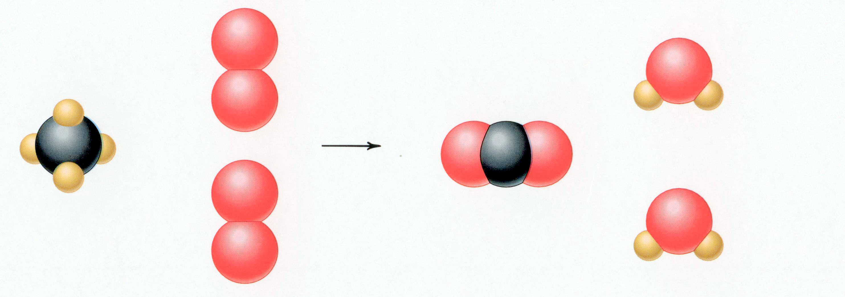
CH₄ + 2 O₂ → CO₂ + 2 H₂O
Reactants Products
1 C atom 1 C atom
4 H atoms 4 H atoms
4 O atoms 4 O atoms
Timberlake, Chemistry 7th Edition, page 167

Slide 4
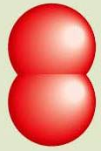
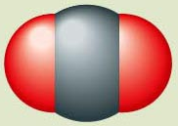
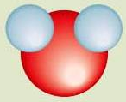

Reactants → Products
+
C(s) + O₂(g) CO₂(g)
carbon oxygen carbon dioxide
Reactants Product
1 carbon atom 1 carbon atom
2 oxygen atoms 2 oxygen atoms
catalyst – speeds up reaction
+
Pt
2
H₂(g) + O₂(g) H₂O (l)
hydrogen oxygen water
2
Pt
Reactants Product
2 hydrogen atoms 2 hydrogen atoms
2 oxygen atoms 1 oxygen atoms
Reactants Product
2 hydrogen atoms 4 hydrogen atoms
2 oxygen atoms 2 oxygen atoms
Reactants Product
4 hydrogen atoms 4 hydrogen atoms
2 oxygen atoms 2 oxygen atoms
Un
balanced
Timberlake, Chemistry 7th Edition, page 164

Slide 5
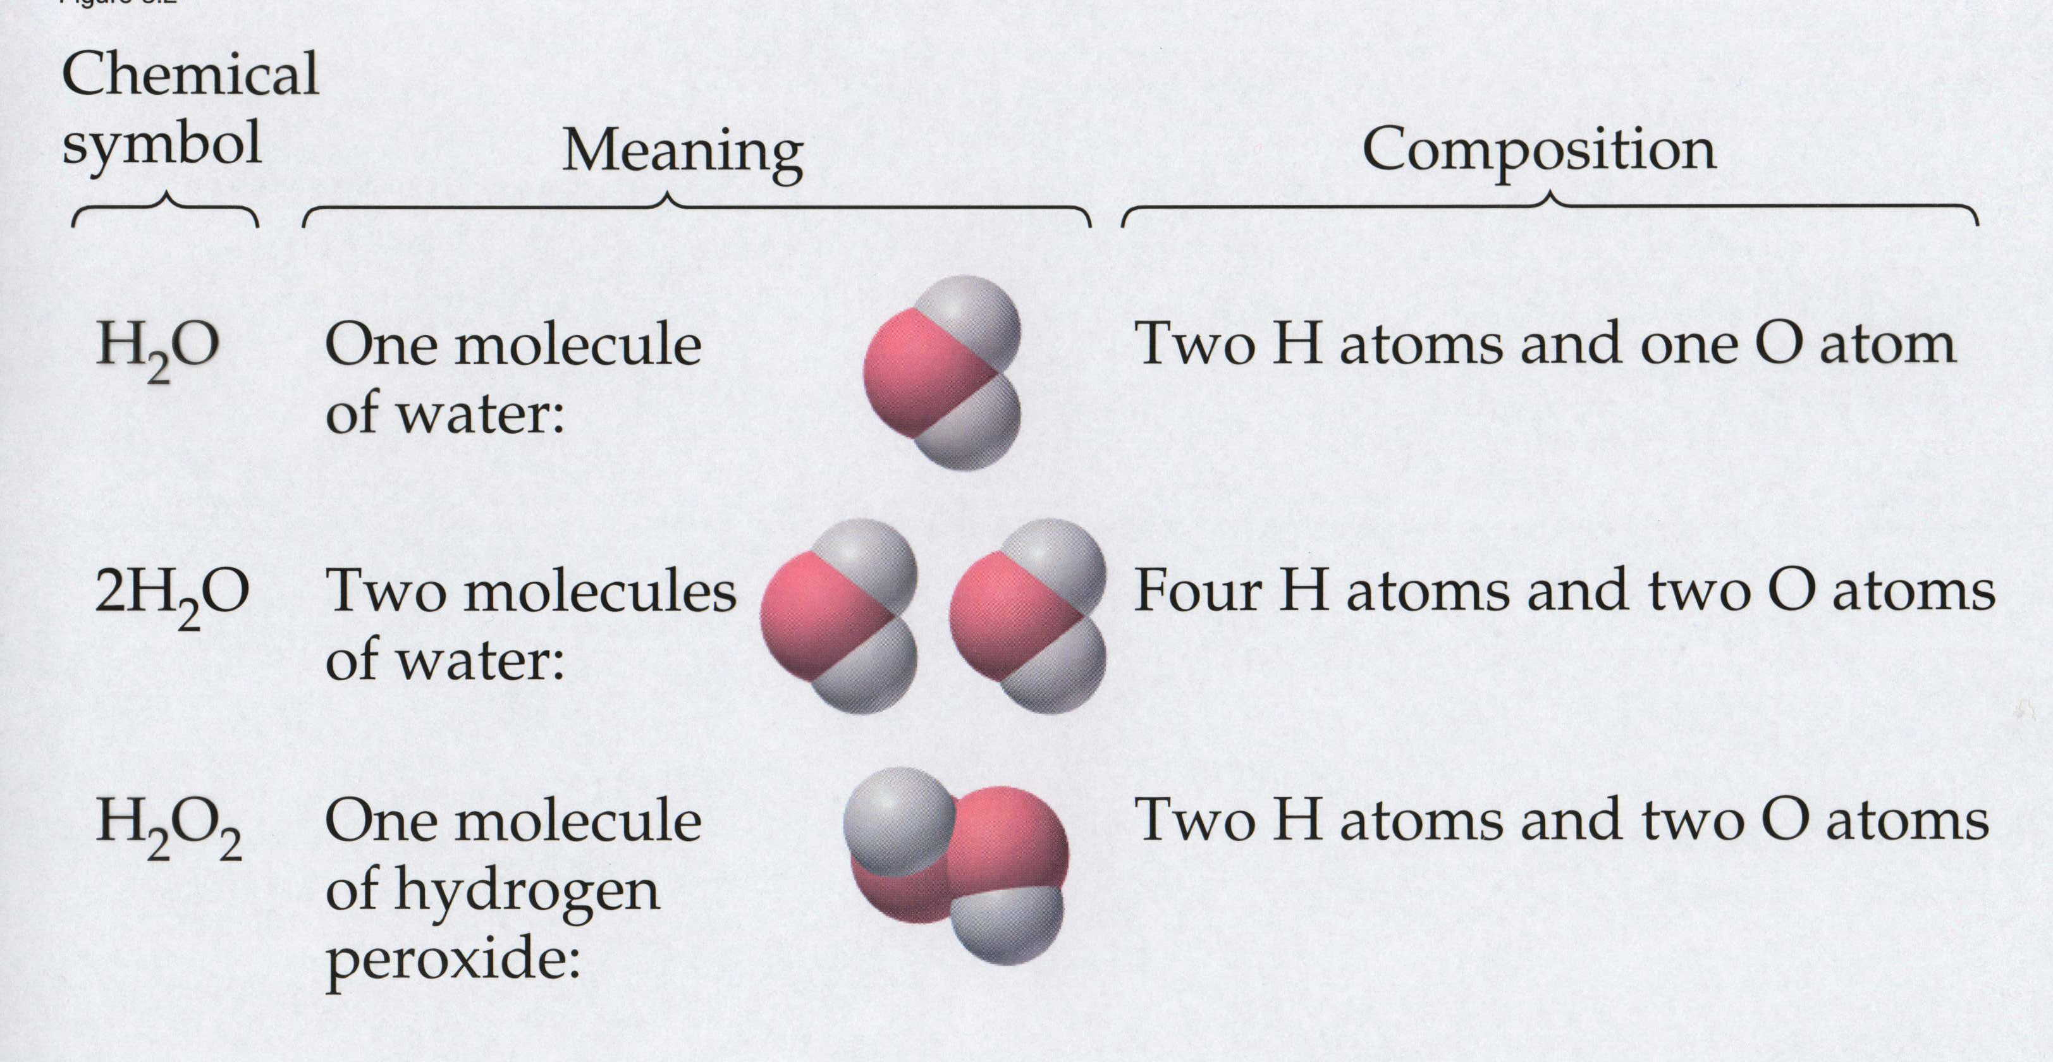
Meaning of Chemical Formula
Chemical
Symbol Meaning Composition
H₂O One molecule
of water:
Two H atoms and one O atom
2 H₂O Two molecules
of water:
Four H atoms and two O atoms
H₂O₂ One molecule
of hydrogen
peroxide:
Two H atoms and two O atoms

Slide 6

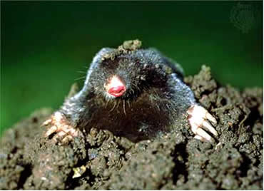
Counting Atoms
Chemistry is a quantitative science - we need a "counting unit."
The MOLE
1 mole is the amount of substance that contains as many particles (atoms or molecules) as there are in 12.0 g of C-12.
Notes:
http://web.syr.edu/~nstefanc/New%20Counting.JPG
http://www.wildcru.org/research/farming/moles/mole1.jpg

Slide 7
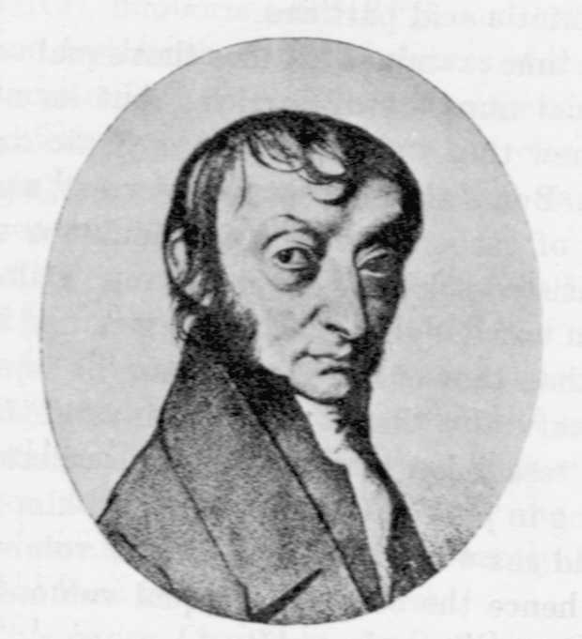
Amadeo
Avogadro
(1776 – 1856)
Particles in a Mole
?
quadrillions
thousands
trillions
billions
millions
1 mole = 602213673600000000000000
or 6.022 x 10²³
There is Avogadro's number of particles in a mole of any substance.
Notes:
A more precise value of Avagadro’s number = 6.022045 E23.
How could you determine the number of sugar crystals in a bowl of sugar?
Is it possible to get a reasonably close estimate?

Slide 8
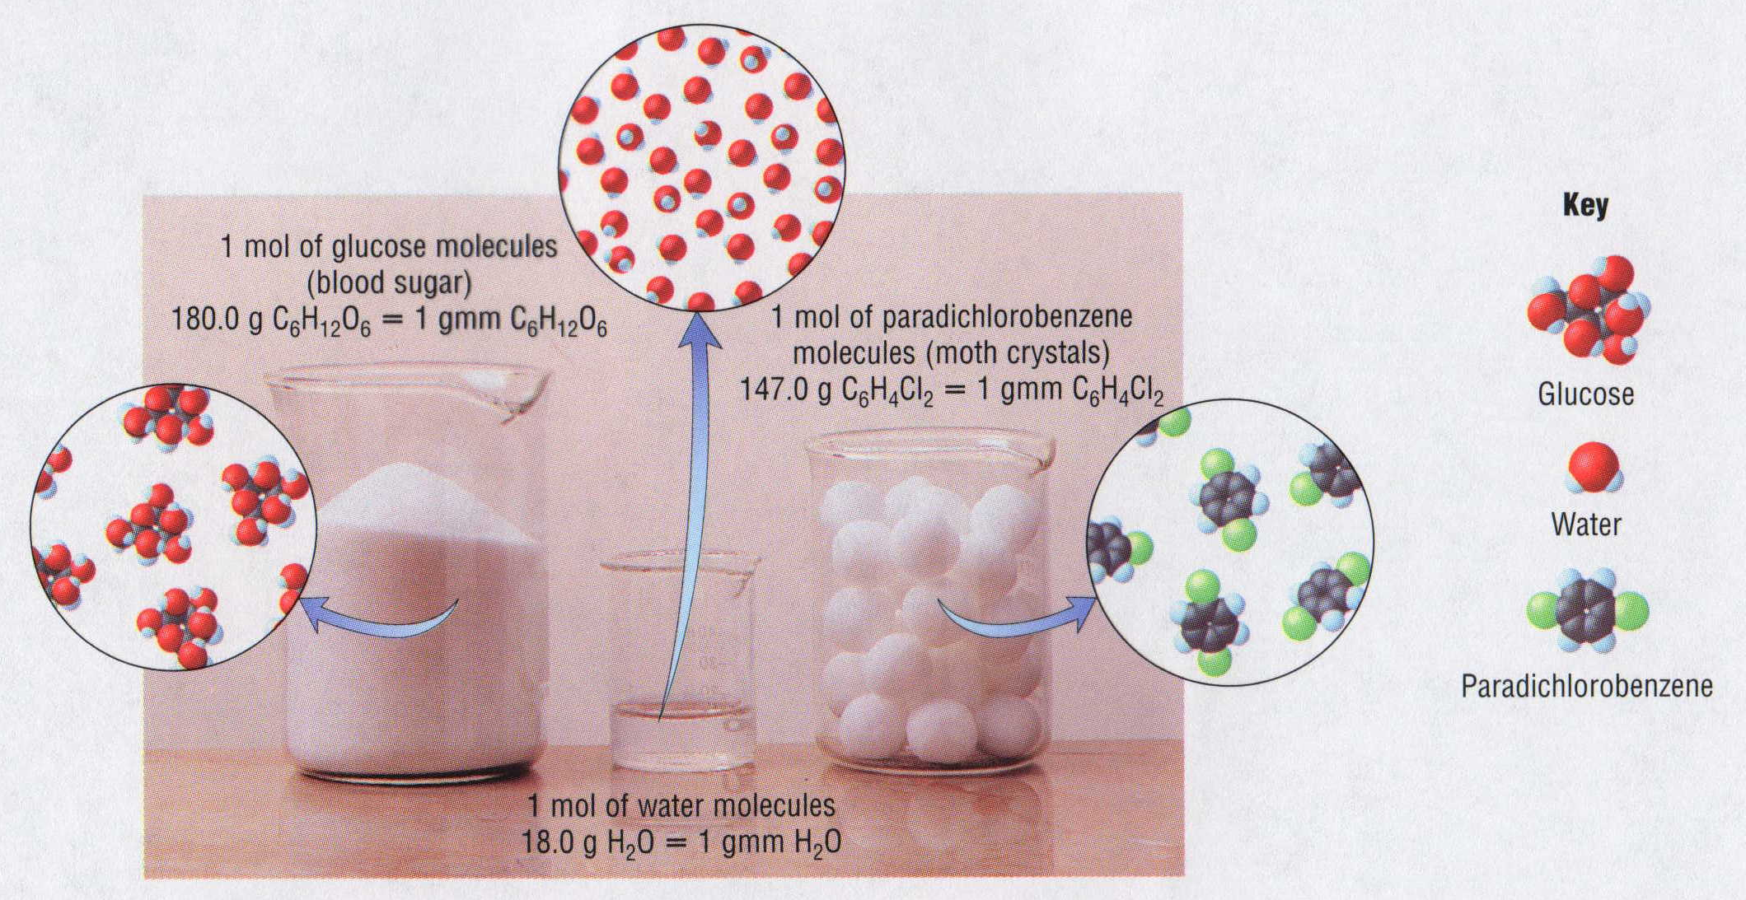
1 Mole of Particles

Slide 9
Reminder…
Molecular Weight and Molar Mass
Molecular weight is the sum of atomic weights
of all atoms in the molecule.
example: NaCl has a molecular weight of 58.5 a.m.u.
this is composed of a single molecule of NaCl
Molar mass = molecular weight in grams.
example: NaCl has a molar mass of 58.5 grams
this is composed of a 6.02 x10²³ molecules of NaCl

Slide 10
The Molar Mass and Number of Particles in One-Mole Quantities
Substance Molar Mass Number of Particles in One Mole
Carbon (C) 12.0 g 6.02 x 10²³ C atoms
Sodium (Na) 23.0 g 6.02 x 10²³ Na atoms
Iron (Fe) 55.9 g 6.02 x 10²³ Fe atoms
NaF (preventative 42.0 g 6.02 x 10²³ NaF formula units
for dental cavities)
CaCO₃ (antacid) 100.1 g 6.02 x 10²³ CaCO₃ formula units
C₆H₁₂O₆ (glucose) 180.0 g 6.02 x 10²³ glucose molecules
C₈H₁₀N₄O₂ (caffeine) 194.0 g 6.02 x 10²³ caffeine molecules

Slide 11
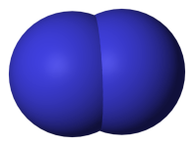
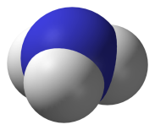
Chemical Equations
Chemical Equations
N₂ (g)
+
3 H₂ (g)
2 NH₃ (g)
+
“Microscopic recipe”
1 molecule N₂
+
3 molecules H₂
2 molecules NH₃
“Macroscopic recipe”
1 mol N₂
+
3 mol H₂
2 mol NH₃
Experimental Conditions Reactants Products
Before reaction
1 mol N₂
+
3 mol H₂
2 mol NH₃
2 molecules N₂
3 molecules H₂
0 molecules NH₃
After reaction
1 molecules N₂
0 molecules H₂
2 molecules NH₃

Slide 12
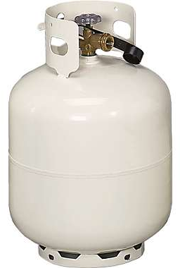
Combustion of a Hydrocarbon
GENERAL FORMULA: CH + O₂ → CO₂ + H₂O
Many homes get heat from propane (C₃H₈) heaters.
Write a balanced chemical equation for the complete
combustion of propane gas.
C₃H₈(g) + O₂(g) → CO₂(g) + H₂O(g)
C₃H₈(g) + O₂(g) → CO₂(g) + H₂O(g)
5
3
4
+ energy
Notes:
http://images.cabelas.com/is/image/cabelas/s7_516602_imageset_01?$main-Large$

Slide 13

Stoichiometry Island Diagram
Known Unknown
Substance A Substance B
M
Mass
Mass Mountain
Mass
Mole Island
V
Volume
Mole
Mole
Volume
Liter Lagoon
Particles
Particles
P
Particle Place
Stoichiometry Island Diagram

Slide 14
Stoichiometry Island Diagram
Known Unknown
Substance A Substance B
Mass
Mass
1 mole = molar mass (g)
1 mole = molar mass (g)
Use coefficients
from balanced
chemical equation
Volume
1 mole = 22.4 L @ STP
Mole
Mole
Volume
1 mole = 22.4 L @ STP
(gases)
(gases)
1 mole = 6.022 x 10²³ particles
(atoms or molecules)
Particles
1 mole = 6.022 x 10²³ particles
(atoms or molecules)
Particles
Stoichiometry Island Diagram

Slide 15
Formation of Ammonia
N₂ (g)
+
3 H₂ (g)
2 NH₃ (g)
+
2 atoms N
+
6 atoms H
2 atoms N and
6 atoms H
1 molecule N₂
+
3 molecules H₂
2 molecules NH₃
10 molecule N₂
+
30 molecules H₂
20 molecules NH₃
1 x
6.02 x 10²³
molecules N₂
+
3 x
6.02 x 10²³
molecules H₂
2 x
6.02 x 10²³
molecules NH₃
1 mol N₂
+
3 mol H₂
2 mol NH₃
28 g N₂
+
3 x 2 g H₂
2 x 17 g NH₃
34 g reactants
34 g products
Assume
STP
22.4
L
+
22.4
L
22.4
L
22.4
L
22.4
L
22.4
L
22.4 L N₂
67.2 L H₂
44.8 L NH₃

Slide 16
Proportional Relationships
Stoichiometry
  mass relationships between substances in a chemical reaction
  based on the mole ratio
Mole Ratio
  indicated by coefficients in a balanced equation
2 Mg + O₂ → 2 MgO
Courtesy Christy Johannesson www.nisd.net/communicationsarts/pages/chem
Notes:
A balanced chemical equation gives the identity of the reactants and products and the accurate number of molecules or moles of each that are consumed or produced.
Stoichiometry is a collective term for the quantitative relationships between the masses, numbers of moles, and numbers of particles (atoms, molecules, and ions) of the reactants and products in a balanced reaction.
A stoichiometric quantity is the amount of product or reactant specified by the coefficients in a balanced chemical equation.

Slide 17
Stoichiometry Steps
1. Write a balanced equation.
2. Identify known & unknown.
3. Line up conversion factors.
  Mole ratio - moles ↔ moles
  Molar mass - moles ↔ grams
  Molarity - moles ↔ liters soln
  Molar volume - moles ↔ liters gas
  Mole ratio - moles ↔ moles
Core step in all stoichiometry problems!!
4. Check answer.
Courtesy Christy Johannesson www.nisd.net/communicationsarts/pages/chem

Slide 18
How many moles of KClO₃ must decompose in order to produce 9 moles of oxygen gas?
2KClO₃ → 2KCl + 3O₂
? mol
9 mol
9 mol O₂
2 mol KClO₃
3 mol O₂
= 6 mol KClO₃
x mol KClO₃ = 9 mol O₂
2 mol KClO₃
6 mol
3 mol O₂
= 6 mol KClO₃
O₂
KClO₃
Courtesy Christy Johannesson www.nisd.net/communicationsarts/pages/chem

Slide 19
Stoichiometry Problems
How many grams of KClO₃ are required to produce 9.00 L of O₂ at STP?
2KClO₃ → 2KCl + 3O₂
? g
9.00 L
9.00 L
O₂
1 mol
O₂
22.4 L
O₂
2 mol
KClO₃
3 mol
O₂
122.55
g KClO₃
1 mol
KClO₃
= 32.8 g
KClO₃
Courtesy Christy Johannesson www.nisd.net/communicationsarts/pages/chem

Slide 20
Stoichiometry Problems
How many grams of KClO₃ are required to produce 9.00 L of O₂ at STP?
2KClO₃ → 2KCl + 3O₂
? g
9.00 L
1 mol O₂
2 mol KClO₃
122.55 g KClO₃
32.8 g
x g KClO₃ = 9.00 L O₂
3 mol O₂
1 mol KClO₃
= 32.8 g KClO₃
22.4 L O₂
O₂
KClO₃
Courtesy Christy Johannesson www.nisd.net/communicationsarts/pages/chem

Slide 21
How many grams of silver will be formed from 12.0 g copper?
Cu + 2 AgNO₃ → 2 Ag + Cu(NO₃)₂
12.0 g
? g
12.0
g Cu
1 mol
Cu
63.55
g Cu
2 mol
Ag
1 mol
Cu
107.87
g Ag
1 mol
Ag
= 40.7 g
Ag
1 mol Cu
2 mol Ag
107.87 g Ag
40.7 g
x g Ag = 12.0 g Cu
1 mol Cu
1 mol Ag
= 40.7 g Ag
63.55 g Cu
Cu
Ag
Courtesy Christy Johannesson www.nisd.net/communicationsarts/pages/chem

Slide 22
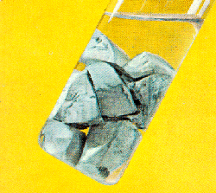
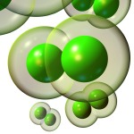
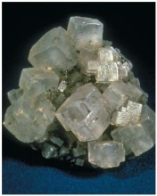
2 Na + Cl₂ 2 NaCl
100 g
x L
x g
W R O N G
2 grams 1 gram 2 grams
Violates Law of Conservation of Matter
1 mol Na
1 mol Cl₂
22.4 L Cl₂
2 atoms 1 molecule 2 molecules*
x L Cl₂ = 100 g Na
= 49 L Cl₂
23 g Na
2 mol Na
1 mol Cl₂
48.69 L
Na
Cl₂
2 moles 1 mole 2 moles
Right side of room…calculate how many grams of NaCl will be produced from 100 g of Na.
x g NaCl = 100 g Na
1 mol Na
2 mol NaCl
58.5 g NaCl
23 g Na
2 mol Na
1 mol NaCl
= 254 g NaCl
Na
NaCl
Left side of room…calculate how many grams of NaCl will be produced from 48.69 L of Cl₂.
x g NaCl = 48.69 L Cl₂
1 mol Cl₂
2 mol NaCl
58.5 g NaCl
22.4 L Cl₂
1 mol Cl₂
1 mol NaCl
= 254 g NaCl
Cl₂
NaCl
*Better name would be “formula unit”
Notes:
http://nobel.scas.bcit.ca/resource/ptable/ptblegif/na.gif
http://www.rkm.com.au/imagelibrary/thumbnails/CHLORINE-Cl2-2-150.jpg
http://www.scienceclarified.com/images/uesc_03_img0170.jpg

Slide 23
Stoichiometry
2
KClO₃
2
KCl
+ O₂
3
500 g
x g
x L
(196 g)
x L O₂ = 500 g KClO₃
1 mol KClO₃
3 mol O₂
22.4 L O₂
= 137 L O₂
122.5 g KClO₃
2 mol KClO₃
1 mol O₂
137 L
KClO₃
O₂
x g O₂ = 137 L O₂
1 mol O₂
32 g O₂
22.4 L O₂
1 mol O₂
= 196 g O₂
x g KCl = 500 g KClO₃
1 mol KClO₃
2 mol KCl
74.5 g KCl
= 304 g KCl
122.5 g KClO₃
2 mol KClO₃
1 mol KCl
(304 g)
KClO₃
KCl

Slide 24
Stoichiometry
2 TiO₂ + 4 Cl₂ + 3 C
CO₂ + 2 CO + 2 TiCl₄
115 g
x mol
4.55 mol
x molecules
x g
How many moles of chlorine will react with 4.55 moles of carbon?
x mol Cl₂ = 4.55 mol C
4 mol Cl₂
3 mol C
= 6.07 mol C
C
Cl₂
How many grams of titanium (IV) oxide will react with 4.55 moles of carbon?
x g TiO₂ = 4.55 mol C
2 mol TiO₂
80 g TiO₂
3 mol C
1 mol TiO₂
= 243 g TiO₂
C
TiO₂
How many molecules of TiCl₄ will react with 115 g TiO₂?
x molecules TiCl₄ = 115 g TiO₂
1 mol TiO₂
2 mol TiCl₄
6.02x10²³ molecules TiCl₄
80 g TiO₂
2 mol TiO₂
1 mol TiCl₄
= 8.66x10²³ molecules TiCl₄
TiO₂
TiCl₄

Slide 25
Which has more atoms:
30 g aluminum metal or 18 mL distilled water?
How many atoms of aluminum are in 30 g of aluminum?
x atoms Al = 30 g Al
1 mol Al
6.02x10²³ atoms Al
= 6.69x10²³ atoms Al
27 g Al
1 mol Al
Al
x atoms Al = 30 g Al
6.02x10²³ atoms Al
= 6.69x10²³ atoms Al
27 g Al
Al
How many atoms are in 18 mL of water?
W R O N G
H₂O
3 atoms
6.02x10²³ atoms H₂O
1 L H₂O
1 mol H₂O
6.02x10²³ molecules H₂O
x atoms = 18 mL H₂O
22.4 L H₂O
1 mol H₂O
1 molecule H₂O
1000 mL H₂O
LITERS is ONLY used for GASES @ STP
= 1.45x10²¹ atoms
How many atoms are in 18 mL of water?
x atoms = 18 mL H₂O
1 g H₂O
1 mol H₂O
6.02x10²³ molecules H₂O
3 atoms
1 mL H₂O
18 g H₂O
1 moL H₂O
1 molecule H₂O
Recall, density of water
= 1.81x10²⁴ atoms

Slide 26




Limiting Reactants
+
plus 16 tires
excess
8 car bodies
48 tires
8 cars
CB + 4 T CT₄
Notes:
http://www.brettschmidt.com/3d_images/garage/samples/car_body.jpg

Slide 27
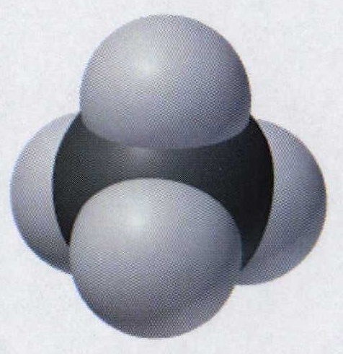
Limiting Reactants
Methane, CH₄
+
plus 8
hydrogen
molecules
excess
plus 16
hydrogen
atoms
excess
8 carbon
atoms
24 hydrogen
molecules
8 methane
molecules
C + 2 H₂ CH₄
Notes:
http://www.brettschmidt.com/3d_images/garage/samples/car_body.jpg

Slide 28
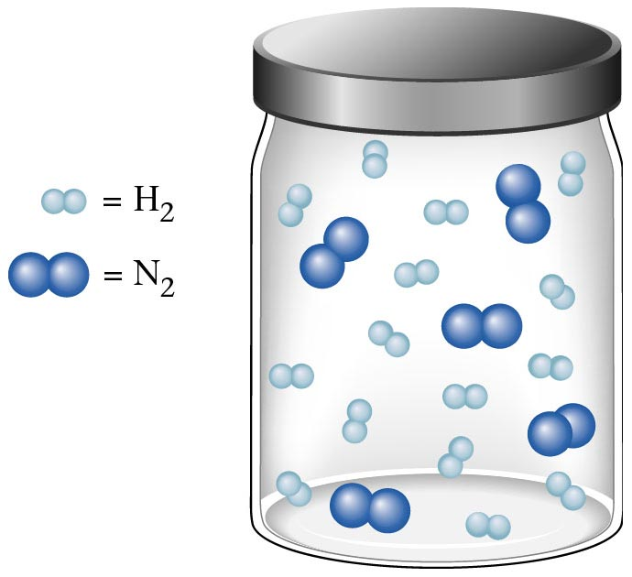
Container 1
Zumdahl, Zumdahl, DeCoste, World of Chemistry 2002, page 269

Slide 29
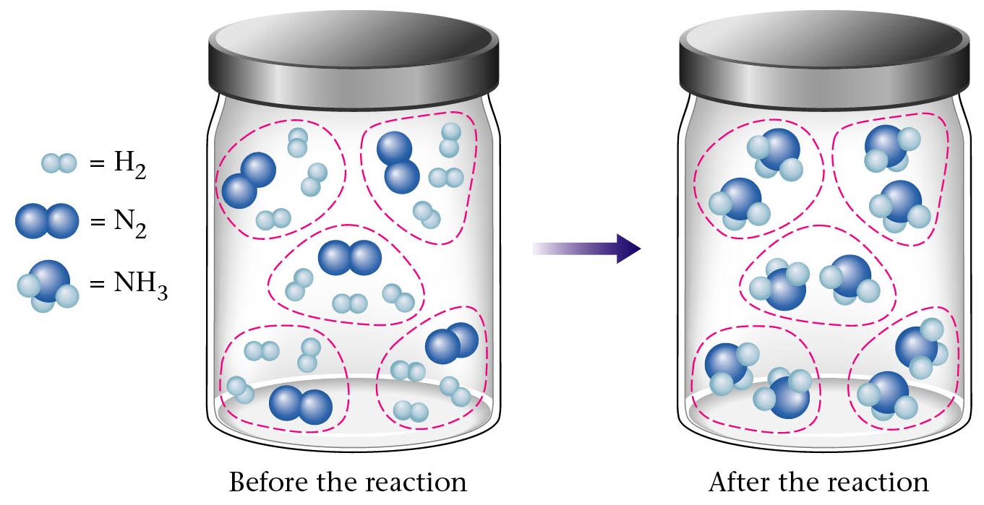
Before and After Reaction 1
2
N₂ + H₂ NH₃
3
Before the reaction
After the reaction
All the hydrogen and nitrogen atoms combine.
Zumdahl, Zumdahl, DeCoste, World of Chemistry 2002, page 269

Slide 30
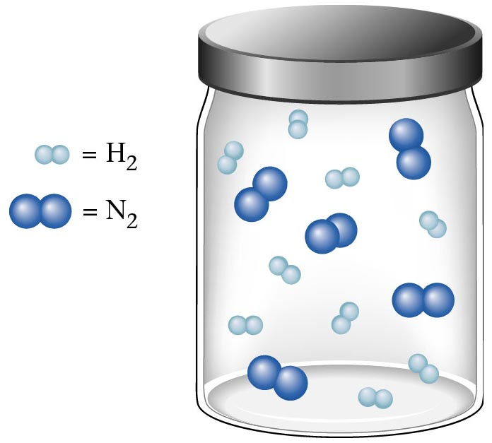
Container 2
Zumdahl, Zumdahl, DeCoste, World of Chemistry 2002, page 270

Slide 31
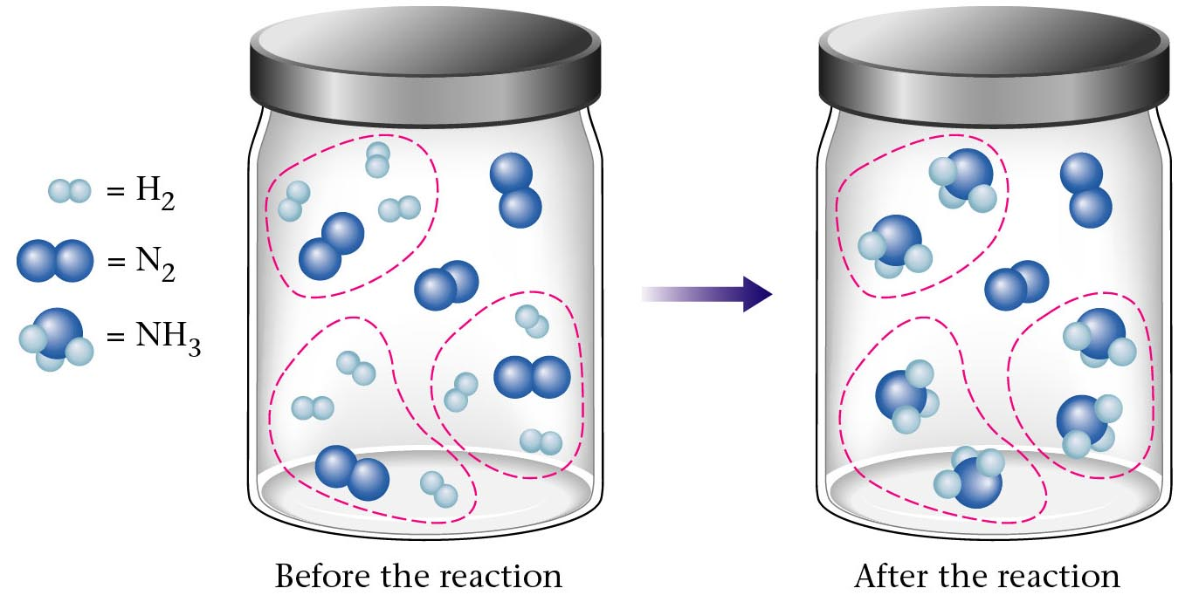
Before and After Reaction 2
2
N₂ + H₂ NH₃
3
excess
limiting
Before the reaction
After the reaction
LIMITING REACTANT DETERMINES AMOUNT OF PRODUCT
Zumdahl, Zumdahl, DeCoste, World of Chemistry 2002, page 270

Slide 32
Real-World Stoichiometry:
Limiting Reactants
Fe + S FeS
Ideal
Stoichiometry
Limiting
Reactants
S =
Fe =
excess
LeMay Jr, Beall, Robblee, Brower, Chemistry Connections to Our Changing World , 1996, page 366

Slide 33
Limiting Reactants
Limiting Reactant
  used up in a reaction
  determines the amount of product
Excess Reactant
  added to ensure that the other reactant is completely used up
  cheaper & easier to recycle
Courtesy Christy Johannesson www.nisd.net/communicationsarts/pages/chem
Notes:
If one or more of the reactants is not used up completely but is left over when the reaction is completed, then the amount of product that can be obtained is limited by the amount of only one of the reactants
A limiting reactant is the reactant that restricts the amount of product obtained. The reactant that remains after a reaction has gone to completion is present in excess.

Slide 34
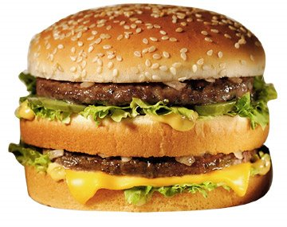
The Limiting Reactant
A balanced equation for making a Big Mac® might be:
3 B + 2 M + EE B₃M₂EE
With… | …and… | …one can make…
excess B and
excess EE
30 M
15 B₃M₂EE
excess M and
excess EE
30 B
10 B₃M₂EE
30 B and
excess EE
30 M
10 B₃M₂EE

Slide 35
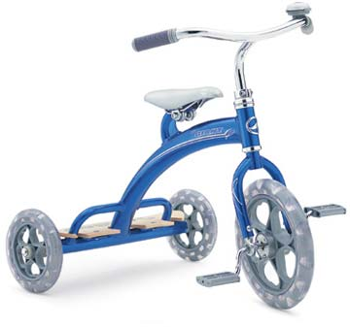
The Limiting Reactant
A balanced equation for making a tricycle might be:
3 W + 2 P + S + H + F W₃P₂SHF
With… | …and… | …one can make…
50 P
excess of all
other reactants
25 W₃P₂SHF
50 S
excess of all
other reactants
50 W₃P₂SHF
50 S and
excess of all
other reactants
50 P
25 W₃P₂SHF

Slide 36

Limiting Reactants
aluminum + chlorine gas → aluminum chloride
Al(s) + Cl₂(g) → AlCl₃
2 Al(s) + 3 Cl₂(g) → 2 AlCl₃
100 g 100 g ? g
A. 200 g B. 125 g C. 667 g D. 494 g

Slide 37
Limiting Reactants
aluminum + chlorine gas → aluminum chloride
2 Al(s) + 3 Cl₂(g) → 2 AlCl₃
100 g 100 g x g
How much product would be made if we begin with 100 g of aluminum?
x g AlCl₃ = 100 g Al
1 mol Al
2 mol AlCl₃
133.5 g AlCl₃
27 g Al
2 mol Al
1 mol AlCl₃
= 494 g AlCl₃
Al
AlCl₃
How much product would be made if we begin with 100 g of chlorine gas?
x g AlCl₃ = 100 g Cl₂
1 mol Cl₂
2 mol AlCl₃
133.5 g AlCl₃
71 g Cl₂
3 mol Cl₂
1 mol AlCl₃
= 125 g AlCl₃
Cl₂
AlCl₃

Slide 38
Limiting Reactants – Method 1
1. Write a balanced equation.
2. For each reactant, calculate the amount of product formed.
3. Smaller answer indicates:
  limiting reactant
  amount of product
Courtesy Christy Johannesson www.nisd.net/communicationsarts/pages/chem

Slide 39
Limiting Reactants – Method 2
Begin by writing a correctly balanced chemical equation
Write down all quantitative values under equation (include units)
Convert ALL reactants to units of moles
Divide by the coefficient in front of each reactant
The smallest value is the limiting reactant!

Slide 40
Generic Stoichiometry
Z (aq) + 2 Y (aq) → 5 M (s) + T₂ (g)
Given the following information:
Z = 20 g/mol
Y = 10 g/mol
M = 6 g/mol
T = 5 g/mol
If you combine 100 g of solution Z with 1.8 x 10²⁴ molecules of solution Y:
How many moles of M will precipitate out of the solution?
What volume of T₂ gas will be produced at STP?

Slide 41
EXCESS
LIMITING
Z (aq) + 2 Y (aq) → 5 M (s) + T ₂(g)
100 g 1.8 x 10²⁴ molecules
x mol
7.5 mol M
33.6 L T₂
/ 20 g /mol
/ 6.02 x 10²³ molecules/mol
2
3 mol Y
5
x mol M
=
x 22.4L/mol
2 : 5
15 = 2x
HAVE
5 mol Z
3 mol Y
Easy
x = 7.5 mol
1
2
2 : 1
1.5 mol T₂
NEED
1.5 mol Z
10 mol Y
5 mol
1.5 mol
LIMITING
SMALLER Number is LIMITING Reactant
EXCESS
x mol M = 1.8 x 10²⁴ molecules Y
1 mol Y
5 mol M
6.02 x 10²³ molecules Y
2 mol Y
= 7.5 mol M
x L T₂ = 3 mol Y
1 mol T₂
22.4 L T₂
2 mol Y
1 mol T₂
= 33.6 L T₂

Slide 42
Z (aq) + 2 Y (aq) → 5 M (s) + T ₂(g)
1.8 x 10²⁴ molecules
x mol
3 mol Y
x mol M = 3 mol Y
5 mol M
2 mol Y
= 7.5 mol M
Y
M

Slide 43

Air Bag Design
Exact quantity of nitrogen gas must be produced in an instant.
Use a catalyst to speed up the reaction
2 NaN₃(s) → 2 Na(s) + 3 N₂(g)
6 Na(s) + Fe₂O₃(s) → 3 Na₂O(s) + 2 Fe (s)

Slide 44
Airbag Design
2 NaN₃(s) → 2 Na(s) + 3 N₂(g)
6 Na(s) + Fe₂O₃(s) → 3 Na₂O(s) + 2 Fe(s)
Assume that 65.1 L of N₂ gas are needed to inflate an air bag to the
proper size. How many grams of NaN₃ must be included in the gas
generant to generate this amount of N₂?
(Hint: The density of N₂ gas at this temperature is about 0.916 g/L).
65.1 L N₂
x 0.916 g/L N₂
1 mol N₂
2 mol NaN₃
65 g NaN₃
x g NaN₃ = 59.6 g N₂
28 g N₂
3 mol N₂
1 mol NaN₃
59.6 g N₂
X = 92.2 g NaN₃
How much Fe₂O₃ must be added to the gas generant for this amount of NaN₃?
1 mol NaN₃
2 mol Na
1 mol Fe₂O₃
159.6 g Fe₂O₃
x g Fe₂O₃ = 92.2 g NaN₃
65 g NaN₃
2 mol NaN₃
6 mol Na
1 mol Fe₂O₃
X = 37.7 g Fe₂O₃

Slide 45
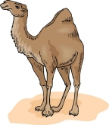
Water from a Camel
Camels store the fat tristearin (C₅₇H₁₁₀O₆) in the hump. As well as
being a source of energy, the fat is a source of water, because when
it is used the reaction
takes place.
2 C₅₇H₁₁₀O₆(s) + 163 O₂(g) → 114 CO₂(g) + 110 H₂O(l)
What mass of water can be made from 1.0 kg of fat?
1000 g “fat”
1 mol “fat”
110 mol H₂O
18 g H₂O
x g H₂O = 1 kg ‘fat”
1 kg “fat”
890 g “fat”
2 mol “fat”
1 mol H₂O
X = 1112 g H₂O
or 1.112 liters water

Slide 46
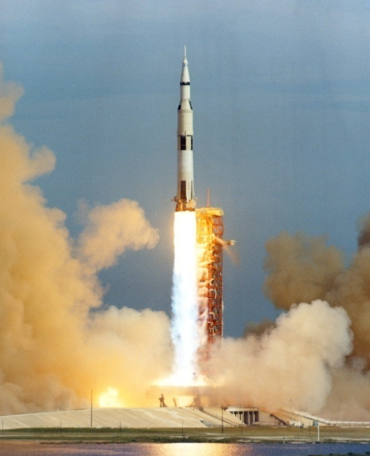
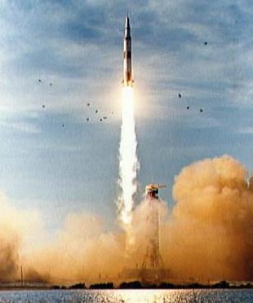

Rocket Fuel
The compound diborane (B₂H₆) was at one time
considered for use as a rocket fuel. How many grams
of liquid oxygen would a rocket have to carry to burn
10 kg of diborane completely?
(The products are B₂O₃ and H₂O).
Chemical equation
B₂H₆ + O₂
B₂O₃ + H₂O
Balanced chemical equation
B₂H₆ + O₂ B₂O₃ + H₂O
3
3
10 kg x g
1000 g B₂H₆
1 mol B₂H₆
3 mol O₂
32 g O₂
x g O₂ = 10 kg B₂H₆
1 kg B₂H₆
28 g B₂H₆
1 mol B₂H₆
1 mol O₂
X = 34,286 g O₂

Slide 47
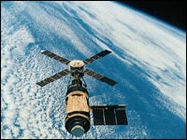

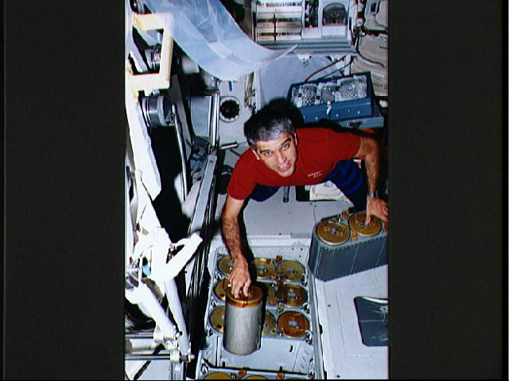
Water in Space
Click
Here
In the space shuttle, the CO₂ that the crew exhales is removed from the
air by a reaction within canisters of lithium hydroxide. On average, each
astronaut exhales about 20.0 mol of CO₂ daily. What volume of water will
be produced when this amount of CO₂ reacts with an excess of LiOH?
(Hint: The density of water is about 1.00 g/mL.)
CO₂(g) + 2 LiOH(s) → Li₂CO₃(aq) + H₂O(l)
20.0 mol
excess
x g
Water is NOT at STP!
1 mol H₂O
18 g H₂O
22.4 L H₂O
1 mL H₂O
x mL H₂O = 20.0 mol CO₂
1 mol CO₂
1 mol H₂O
1 g H₂O
X = 360 mL H₂O

Slide 48
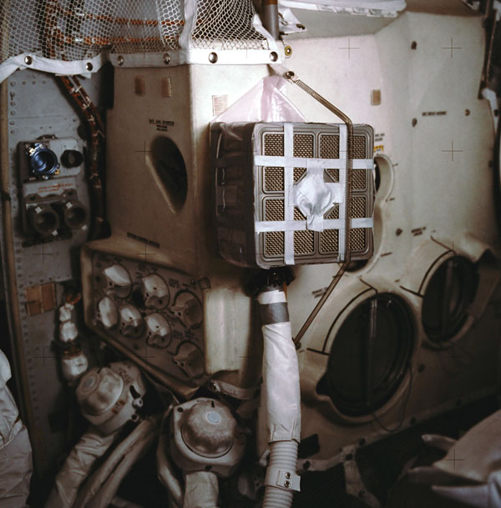
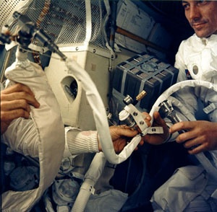
Lithium Hydroxide Scrubber
Modified by Apollo 13 Mission
Astronaut John L. Swigert holds the
jury-rigged lithium hydroxide scrubber
used to remove excess carbon dioxide
from the damaged Apollo 13 spacecraft.
Notes:
http://images.google.com/imgres?imgurl=http://www.space1.com/Artifacts/Apollo_Artifacts/LiOH_Canister/apollo_13_photo2_600.jpg&imgrefurl=http://www.space1.com/Artifacts/Apollo_Artifacts/LiOH_Canister/lioh_canister.html&h=609&w=600&sz=99&hl=en&start=7&tbnid=IN4zfhqzwnHKYM:&tbnh=136&tbnw=134&prev=/images%3Fq%3DApollo%2B%2B13%2Blithium%2Bhydroxide%2Bscrubber%26gbv%3D2%26svnum%3D10%26hl%3Den
http://www.spurgeonworld.com/blog/images/as13-62-9004.jpg
Interior view of the Apollo 13 Lunar Module (LM) as the astronauts jerry-rig a system to use the Command Module lithium hydroxide canisters to purge carbon dioxide from the LM. Photo: NASA/JSC

Slide 49
Water in Space
In the space shuttle, the CO₂ that the crew exhales is removed from the
air by a reaction within canisters of lithium hydroxide. On average, each
astronaut exhales about 20.0 mol of CO₂ daily. What volume of water will
be produced when this amount of CO₂ reacts with an excess of LiOH?
(Hint: The density of water is about 1.00 g/mL.)
CO₂(g) + 2 LiOH(s) → Li₂CO₃(aq) + H₂O(l)
20.0 mol
excess
x g
Water is NOT at STP!
1 mol H₂O
18 g H₂O
22.4 L H₂O
1 mL H₂O
x mL H₂O = 20.0 mol CO₂
1 mol CO₂
1 mol H₂O
1 g H₂O
X = 360 mL H₂O

Slide 50
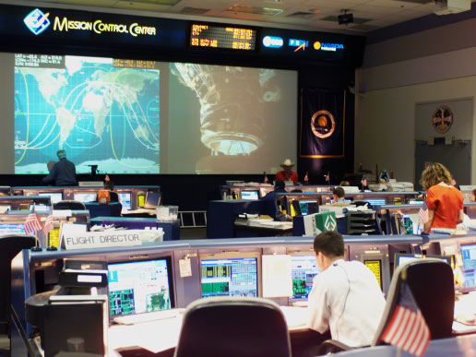
Real Life Problem Solving
Determine the amount of LiOH required for a seven-day mission in space
for three astronauts and one ‘happy’ chimpanzee. Assume each passenger
expels 20 mol of CO₂ per day.
Note: The lithium hydroxide scrubbers are only 85% efficient.
(4 passengers) x (10 days) x (20 mol/day) = 800 mol CO₂
Plan for a delay
CO₂(g) + 2 LiOH(s) → Li₂CO₃(aq) + H₂O(l)
800 mol X g
Notes:
http://www.nasa.gov/images/content/64569main_ffs_gallery_mcc_image3.jpg

Slide 51
CO₂(g) + 2 LiOH(s) → Li₂CO₃(aq) + H₂O(l)
800 mol
38,240 g
x g
x 23.9 g/mol
800 mol
1:2
1600 mol
Needed
(actual yield)
2 mol LiOH
23.9 g LiOH
X g LiOH = 800 mol CO₂
= 38,240 g LiOH
1 mol CO₂
1 mol LiOH
Note: The lithium hydroxide scrubbers are only 85% efficient.
Actual Yield
Theoretical Yield
38,240 g LiOH
% Yield =
0.85
=
x g LiOH
Amount of LiOH to
be taken into space
x = 44,988 g LiOH

Slide 52
Careers in Chemistry: Farming
Farming is big business in the United States with profits for the lucky and
possible bankruptcy for the less fortunate. Farmers should not be ignorant of
chemistry. For instance, to be profitable, a farmer must know when to plant,
harvest, and sell his/her crops to maximize profit. In order to get the greatest
yield farmers often add fertilizers to the soil to replenish vital nutrients removed
by the previous season’s crop.
Corn is one product that removes a tremendous amount of phosphorous
from the soil. For this reason, farmers will rotate crops and/or add fertilizer to
the ground before planting crops for the following year. On average, an acre
of corn will remove 6 kilograms of phosphorous from the ground.
Assume you inherit a farm and must now have to purchase fertilizer for the
farm. The farm is 340 acres and had corn planted the previous year. You must
add fertilizer to the soil before you plant this years’ crop. You go to the local
fertilizer store and find SuperPhosphateTM brand fertilizer. You read the fertilizer
bag and can recognize from your high school chemistry class a molecular formula Ca₃P₂H₁₄S₂O₂₁ (you don’t understand anything else written on the bag because it
is imported fertilizer from Japan). You must decide how much fertilizer to buy for application to your corn fields. If each bag costs $54.73; how many bags of
fertilizer must you purchase and how much will it cost you to add the necessary fertilizer to your fields?
Given: 1 bag of fertilizer weighs 10,000 g [454 g = 1 pound]

Slide 53
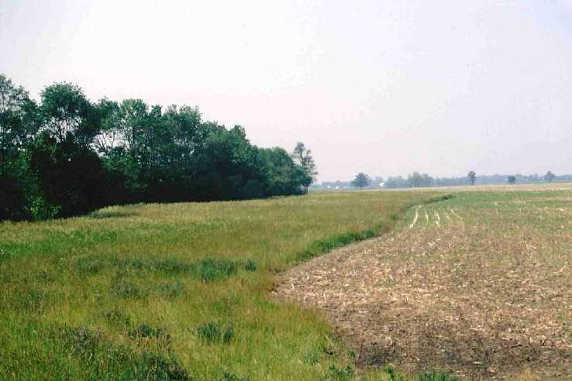
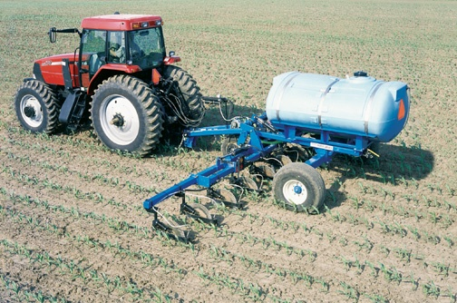
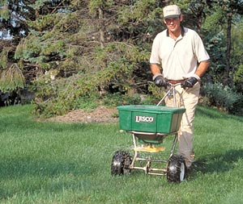
Careers in Chemistry: Farming
How much fertilizer will you need?
Conversion Factor: 1 acre corn = 6 kg phosphorous
If a bag of fertilizer has the formula Ca₃P₂H₁₄S₂O₂₁,
The molar mass of it is 596 g/mol.
3 Ca @ 40g/mol = 120 g
2 P@ 31 g/mol = 62 g
14 H@ 1 g/mol = 14 g
2 S@ 32 g/mol = 64 g
21 O @ 16 g/mol = 335 g
Ca₃P₂H₁₄S₂O₂₁
In a bag of fertilizer you have 10.4 % (by mass) phosphorous.
A bag of fertilizer weighs 10,000 g (about 22 pounds).
10.4 % of 10,000 g =
2.04 x 10⁶ g P
1040 g/bag
Total Cost
x g P = 340 acres
6 kg P
1000 g P
=
2.04 x 10⁶ g P
1 acre
1 kg P
part
62 g
x 100
%
% P =
whole
596 g
10.4 % Phosphorous
= 596 g
1040 g phosphorous / bag of fertilizer
= 1962 bags of fertilizer
(1962 bags of fertilizer)($54.73 / bag) =
$107,380
Notes:
http://www.wylie-caseih.com/images/NEW2004/DMI/NutriPlacr_2800_7.jpg
http://www.greenprolawncare.com/art/yard-picture.jpg
http://www.oh.nrcs.usda.gov/programs/Lake_Erie_Buffer/images/grass_fs_wise2.jpg

Slide 54
Careers in Chemistry: Dentistry
We learned that fluoride is an essential element to be taken to reduce
teeth cavities. Too much fluoride can produce yellow spots on the teeth
and too little will have no effect. After years of study it was determined
that a quantity of 1 part per million (ppm) fluoride in the water supply is
enough to significantly reduce cavities and not stain teeth yellow.
Measure the mass of the mineral fluorite (chemically, CaF₂). Use this
sample to determine how much water must be added to yield a 1 ppm
fluoride solution. Sounds difficult? Lets apply what we’ve learned this
unit to solve this problem.
1 part per million = 1 atom of fluorine per 999,999 water molecules
What information do we know:
  1 mol CaF₂ = 78.08 g CaF₂ = 6.02 x 10²³ molecules of CaF₂
  1 molecules of CaF₂ = 2 atoms of F
  1 mol H₂O = 18 g H₂O Density of water is 1 g/mL
  1000 mL = 1 L and 3.78 L = 1 gallon
  mass of sample of CaF₂ = 92.135 g

Slide 55
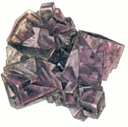

Careers in Chemistry: Dentistry
Calcium Fluoride
x atoms F = 92.135 g CaF₂
1 mol CaF₂
6.02 x 10²³ molecules CaF₂
2 atoms F
=
1.42 x 10²⁴ atoms F
78 g CaF₂
1 mol CaF₂
1 molecules CaF₂
x gallons H₂O = 1.42 x 10²⁴ F atoms
999,999 H₂O molecules
1 mol H₂O
18 g H₂O
1 mL H₂O
1 L H₂O
1 gallon H₂O
=
1 F atom
6.02 x 10²³ H₂O molecules
1 mol H₂O
1 g H₂O
1000 mL H₂O
3.78 L H₂O
Need 11,238 gallons of water needed to dissolve 91.235 g CaF₂ to yield a 1 ppm F¹⁻ solution.

Slide 56
Energy with Stoichiometry
350 kJ
Given: 1 mol O₂ yields 350 kJ
?
methane
+
oxygen
carbon dioxide
+
water
+
energy
Excess
Limiting
CH₄
+
2
O₂
CO₂
+
2
H₂O
+
700 kJ
100 g
100 g
? kJ
/ 16 g/mol
/ 32 g/mol
700 kJ
x kJ = 3.125 mol O₂
=
1094 kJ
2 mol O₂
6.25 mol CH₄
3.125 mol O₂
1
2
6.25
1.56
smaller number
is limiting reactant

Slide 57
Excess Reactant
2 Na + Cl₂ → 2 NaCl
81.9 g NaCl
50 g 50 g x g
/ 23 g/mol
/ 71 g/mol
x 58.5 g/mol
1 : 2
1.40 mol
“Have”
2.17 mol
0.70 mol
coefficients
“Need”
1.40 mol
EXCESS
LIMITING

Slide 58
Excess Reactant (continued)
excess
limiting
2 Na + Cl₂ → 2 NaCl
81.9 g NaCl
50 g 50 g x g
All the chlorine is used up…
81.9 g NaCl
50.0 g Cl₂
31.9 g
Na is consumed in reaction.
How much Na is unreacted?
50.0 g - 31.9 g =
18.1 g Na
total used “excess”

Slide 59
Conservation of Mass is Obeyed
2 Na + Cl₂ → 2 NaCl
81.9 g NaCl
50 g 50 g x g
2 Na + Cl₂ → 2 NaCl
+ Na
50 g
81.9 g NaCl
50 g x g
18.1 g
31.9 g +
18.1 g
100 g product
81.9 g product
100 g reactant
81.9 g reactant

Slide 60
Solid aluminum react with chlorine gas to yield solid aluminum chloride.
2
Al(s) + Cl₂(g) AlCl₃(s)
3
2
excess
excess
x g
125 g
125 g
If 125 g aluminum react with excess chlorine, how many grams of aluminum chloride are made?
x g AlCl₃ = 125 g Al
1 mol Al
2 mol AlCl₃
133.5 g AlCl₃
27 g Al
2 mol Al
1 mol AlCl₃
= 618 g AlCl₃
Al
AlCl₃
If 125 g chlorine react with excess aluminum, how many grams of aluminum chloride are made?
x g AlCl₃ = 125 g Cl₂
1 mol Cl₂
2 mol AlCl₃
133.5 g AlCl₃
71 g Cl₂
3 mol Cl₂
1 mol AlCl₃
= 157 g AlCl₃
Cl₂
AlCl₃
If 125 g aluminum react with 125 g chlorine, how many grams of aluminum chloride are made?
157 g AlCl₃
We’re out of Cl₂

Slide 61
Solid aluminum react with chlorine gas to yield solid aluminum chloride.
If 125 g aluminum react with excess chlorine, how many grams of aluminum chloride are made?
2
Al(s) + Cl₂(g) AlCl₃(s)
3
2
125 g
excess
x g
618 g AlCl₃
/ 27 g/mol
x 133.5 g/mol
2:2
4.6 mol Al
4.6 mol AlCl₃
Step 1
Step 2
Step 3
x g AlCl₃ = 125 g Al
1 mol Al
2 mol AlCl₃
133.5 g AlCl₃
27 g Al
2 mol Al
1 mol AlCl₃
= 618 g AlCl₃
Al
AlCl₃

Slide 62
Solid aluminum react with chlorine gas to yield solid aluminum chloride.
If 125 g chlorine react with excess aluminum, how many grams of aluminum chloride are made?
2
Al(s) + Cl₂(g) AlCl₃(s)
3
2
excess
125 g
x g
157 g AlCl₃
/ 71 g/mol
x 133.5 g/mol
3:2
1.76 mol Cl₂
1.17 mol AlCl₃
3
1.76 mol Al
=
2
x mol Al
3x = 3.52
x = 1.17 mol
Step 1
Step 2
Step 3
x g AlCl₃ = 125 g Cl₂
1 mol Cl₂
2 mol AlCl₃
133.5 g AlCl₃
71 g Cl₂
3 mol Cl₂
1 mol AlCl₃
= 157 g AlCl₃
Cl₂
AlCl₃

Slide 63
Limiting Reactant Problems
1. According to the balanced chemical equation, how many atoms of silver will be produced from combining
100 g of copper with 200 g of silver nitrate?
Easy
Cu(s) + 2 AgNO₃(aq) Cu(NO₃)₂(aq) + 2 Ag(s)
2. At STP, what volume of “laughing gas” (dinitrogen monoxide) will be produced from 50 g of nitrogen gas
and 75 g of oxygen gas?
Easy
3. Carbon monoxide can be combined with hydrogen to produce methanol, CH₃OH. Methanol is used as an
industrial solvent, as a reactant in some synthesis reactions, and as a clean-burning fuel for some
racing cars. If you had 152 kg of carbon monoxide and 24.5 kg of hydrogen gas, how many kilograms
of methanol could be produced?
Easy
4. How many grams of water will be produced from 50 g of hydrogen and 100 g of oxygen?
Easy
Answers: 1. 7.1 x 10²³ atoms Ag 2. 40 dm³ N₂O 3. 174.3 kg CH₃OH 4. 112.5 g H₂O

Slide 64
Limiting Reactant Problems
1. According to the balanced chemical equation, how many atoms of silver will be produced from combining
100 g of copper with 200 g of silver nitrate?
Back
Cu(s) + 2 AgNO₃(aq) Cu(NO₃)₂(aq) + 2 Ag(s)
Excess
Limiting
x atoms
100 g
200 g
/ 63.5 g/mol
/ 170 g/mol
1.57 mol Cu
1.18 mol AgNO₃
1
2
1.57
0.59
smaller number
is limiting reactant
2 mol Ag
6.02 x 10²³ atoms Ag
=
7.1 x 10²³ atoms Ag
x atoms Ag = 1.18 mol AgNO₃
7.1 x 10²³ atoms
2 mol AgNO₃
1 mol Ag

Slide 65
Limiting Reactant Problems
2. At STP, what volume of “laughing gas” (dinitrogen monoxide) will be produced from 50 g of nitrogen gas
and 75 g of oxygen gas?
Back
2 N₂(g) + O₂(g) 2 N₂O(g)
Limiting
Excess
x L
50 g
75 g
/ 28 g/mol
/ 32 g/mol
1.79 mol N₂
2.34 mol O₂
2
1
0.89
2.34
smaller number
is limiting reactant
2 mol N₂O
22.4 L N₂O
=
40 L N₂O
x L N₂O = 1.79 mol N₂
40 L N₂O
2 mol N₂
1 mol N₂O

Slide 66
Limiting Reactant Problems
3. Carbon monoxide can be combined with hydrogen to produce methanol, CH₃OH. Methanol is used as an
industrial solvent, as a reactant in some synthesis reactions, and as a clean-burning fuel for some
racing cars. If you had 152 kg of carbon monoxide and 24.5 kg of hydrogen gas, how many kilograms
of methanol could be produced?
Back
CO (g) + 2 H₂(g) CH₃OH (g)
Limiting
Excess
x g
174.3 kg
152.5 g
24.5 g
/ 28 g/mol
/ 2 g/mol
Work the entire problem with the mass
in grams. At the end, change answer
to units of kilograms.
5.45 mol CO
12.25 mol H₂
1
2
5.45
6.125
smaller number
is limiting reactant
1 mol CH₃OH
32 g CH₃OH
=
174.3 g
x g CH₃OH = 5.45 mol CO
174.3 g CH₃OH
1 mol CO
1 mol CH₃OH

Slide 67
Limiting Reactant Problems
4. How many grams of water will be produced from 50 g of hydrogen and 100 g of oxygen?
Back
2 H₂(g) + O₂(g) 2 H₂O(g)
Excess
Limiting
x g
50 g
100 g
/ 2 g/mol
/ 32 g/mol
25 mol H₂
3.125 mol O₂
2
1
12.5
3.125
smaller number
is limiting reactant
2 mol H₂O
18 g H₂O
=
112.5 g H₂O
x g H₂O = 3.125 mol O₂
112.5 g
1 mol O₂
1 mol H₂O

Slide 68
Limiting Reactant Problems - continued
5. An unbalanced chemical equation is given as __N₂H₄(l) + __N₂O₄(l) __N₂(g) + __ H₂O(g).
If you begin with 400 g of N₂H₄ and 900 g of N₂O₄…
2
3
4
Easy
A. Find the number of liters of water produced (at STP), assuming the reaction goes to completion.
Easy
B. Find the number of liters of nitrogen produced at STP, assuming the reaction goes to completion.
Easy
C. Find the mass of excess reactant left over at the conclusion of the reaction.
4
2
6. An unbalanced chemical equation is given as __Na(s) + __O₂(g) __Na₂O (s)
If you have 100 g of sodium and 60 g of oxygen…
Easy
A. Find the number of moles of sodium oxide produced.
Easy
B. Find the mass of excess reactant left over at the conclusion of the reaction.
Answers: 5A. 560 L H₂O (@STP - gas) 5B. 420 L N₂ 5C. 325 g N₂O₄ excess 6A. 2.17 mol Na₂O 6B. 25.2 g O₂ excess
or 0.45 L H₂O
Notes:
Number 5A is not a reasonable question. Water at STP is NOT a gas. I also have a slide (next slide) that shows how the problem should be phrased and worked out.

Slide 69
Limiting Reactant Problems
5. An unbalanced chemical equation is given as __N₂H₄(l) + __N₂O₄(l) __N₂(g) + __ H₂O(g).
If you begin with 400 g of N₂H₄ and 900 g of N₂O₄…
2
3
4
A. Find the number of liters of water produced at STP, assuming the reaction goes to completion.
Back
2 N₂H₄(l) + N₂O₄(l) 3 N₂(g) + 4 H₂O(g)
400 g
x L
900 g
x L
/ 32 g/mol
/ 92 g/mol
12.5 mol N₂H₄
9.78 mol N₂O₄
2
1
Water is a SOLID at STP
… this isn’t possible!
Density of water
is 1.0 g/mL
6.25
9.78
smaller number
is limiting reactant
4 mol H₂O
22.4 L H₂O
4 mol H₂O
18 g H₂O
1 mL H₂O
=
1 L H₂O
560 L H₂O
x L H₂O = 12.5 mol N₂H₄
560 L H₂O
=
0.45 L H₂O
x L H₂O = 12.5 mol N₂H₄
2 mol N₂H₄
1 mol H₂O
0.45 L H₂O
2 mol N₂H₄
1 mol H₂O
1.0 g H₂O
1000 mL H₂O

Slide 70
Limiting Reactant Problems
5. An unbalanced chemical equation is given as __N₂H₄(l) + __N₂O₄(l) __N₂(g) + __ H₂O(l).
If you begin with 400 g of N₂H₄ and 900 g of N₂O₄…
2
3
4
A. Find the number of liters of water produced, assuming the reaction goes to completion.
Back
2 N₂H₄(l) + N₂O₄(l) 3 N₂(g) + 4 H₂O(g)
400 g
900 g
x L
/ 32 g/mol
/ 92 g/mol
12.5 mol N₂H₄
9.78 mol N₂O₄
2
1
Density of water
is 1.0 g/mL
6.25
9.78
smaller number
is limiting reactant
4 mol H₂O
18 g H₂O
1 mL H₂O
1 L H₂O
=
0.45 L H₂O
x L H₂O = 12.5 mol N₂H₄
0.45 L H₂O
2 mol N₂H₄
1 mol H₂O
1.0 g H₂O
1000 mL H₂O

Slide 71
Limiting Reactant Problems
5. An unbalanced chemical equation is given as __N₂H₄(l) + __N₂O₄(l) __N₂(g) + __ H₂O(g).
If you begin with 400 g of N₂H₄ and 900 g of N₂O₄…
2
3
4
B. Find the number of liters of nitrogen produced at STP, assuming the reaction goes to completion.
Back
2 N₂H₄(l) + N₂O₄(l) 3 N₂(g) + 4 H₂O(g)
400 g
900 g
x L
/ 32 g/mol
/ 92 g/mol
12.5 mol N₂H₄
9.78 mol N₂O₄
2
1
6.25
9.78
smaller number
is limiting reactant
3 mol N₂
22.4 L N₂
=
420 L N₂
x L N₂ = 12.5 mol N₂H₄
420 L N₂
2 mol N₂H₄
1 mol N₂

Slide 72
Limiting Reactant Problems
5. An unbalanced chemical equation is given as __N₂H₄(l) + __N₂O₄(l) __N₂(g) + __ H₂O(g).
If you begin with 400 g of N₂H₄ and 900 g of N₂O₄…
2
3
4
C. Find the mass of excess reactant left over at the conclusion of the reaction.
Back
2 N₂H₄(l) + N₂O₄(l) N₂(g) + H₂O(g)
400 g
x g
575 g
/ 32 g/mol
x 92 g/mol
900 g N₂O₄ have
- needed
325 g N₂O₄ excess
12.5 mol N₂H₄
6.25 mol N₂O₄
1 mol N₂O₄
92 g N₂O₄
=
575 g N₂O₄
x g N₂O₄ = 12.5 mol N₂H₄
575 g N₂O₄
2 mol N₂H₄
1 mol N₂O₄

Slide 73
Limiting Reactant Problems
6. An unbalanced chemical equation is given as __Na(s) + __O₂(g) __Na₂O (s)
If you have 100 g of sodium and 60 g of oxygen…
4
2
Back
A. Find the number of moles of sodium oxide produced.
4 Na(s) + O₂ (g) 2 Na₂O (s)
100 g
60 g
x mol
/ 23 g/mol
/ 32 g/mol
4.35 mol Na
1.875 mol O₂
4
1
1.087
1.875
smaller number
is limiting reactant
2 mol Na₂O
=
2.17 mol Na₂O
x mol Na₂O = 4.35 mol Na
2.17 mol
4 mol Na

Slide 74
Limiting Reactant Problems
6. An unbalanced chemical equation is given as __Na(s) + __O₂(g) __Na₂O (s)
If you have 100 g of sodium and 60 g of oxygen…
4
2
B. Find the mass of excess reactant left over at the conclusion of the reaction.
Back
4 Na(s) + O₂ (g) 2 Na₂O (s)
100 g
x g
34.8 g
/ 23 g/mol
x 32 g/mol
60 g O₂ have
- needed
25.2 g O₂ excess
4.35 mol Na
1.087 mol O₂
1 mol O₂
32 g O₂
=
34.8 g O₂
x g O₂ = 4.35 mol Na
34.8 g O₂
4 mol Na
1 mol O₂

Slide 75
Percent Yield
measured in lab
actual yield
=
x 100
% yield
theoretical yield
calculated on paper
Notes:
Courtesy Christy Johannesson www.nisd.net/communicationsarts/pages/chem
Limiting reactant determines the maximum amount of product that can be formed from the reactants when reactants are not present in stoichiometric quantities.
Amount of product calculated in this way is the theoretical yield, the amount you would obtain if the reaction occurred perfectly and your method of purifying the product was 100% efficient.
Always obtain less product than is theoretically possible. Actual yield, the measured mass of products obtained from a reaction, is less than the theoretical yield.
Percent yield of a reaction is the ratio of the actual yield to the theoretical yield, multiplied by 100% to give a percentage.

Slide 76
When 45.8 g of K₂CO₃ react with excess HCl, 46.3 g of KCl are formed. Calculate the theoretical and % yields of KCl.
actual yield
46.3 g
K₂CO₃ +
2
HCl
2
KCl
+ H₂O + CO₂
+ H₂CO₃
45.8 g
excess
? g
theoretical yield
Theoretical yield
1 mol K₂CO₃
2 mol KCl
74.5 g KCl
x g KCl = 45.8 g K₂CO₃
= 49.4 g KCl
49.4 g
49.4 g KCl
138 g K₂CO₃
1 mol K₂CO₃
1 mol KCl
Actual Yield
Theoretical Yield
46.3 g KCl
% Yield =
% Yield
=
x 100
% Yield = 93.7% efficient
Notes:
Example courtesy Christy Johannesson www.nisd.net/communicationsarts/pages/chem

Slide 77
Percent Yield
actual yield
Need 500 g of Y
500 g
500 g
…% yield = 80%
0.80
=
% yield =
80
x 100 %
x g
theoretical yield
actual yield
0.80 x = 500 g
0.80
0.80
W₂ + 2X Y
625 g
x = 625 g
x atoms
x L @STP
x g
theoretical yield
1 mol Y
1 mol W₂
6.02 x 10²³ molecules W₂
2 atoms W
x atoms W = 625 g Y
89 g Y
1 mol Y
1 mol W₂
1 molecule W₂
1 mol Y
2 mol X
22.4 L X
=
315 L X
x L X = 625 g Y
8.45 x 10²⁴ atoms W
315 L X
8.45 x 10²⁴ atoms W
89 g Y
1 mol Y
1 mol X

Slide 78
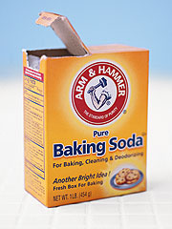
Baking Soda Lab
Print
Copy of Lab
Na
NaHCO₃
HCl
+
HCO₃
+
H
Cl
H₂CO₃
H₂CO₃
sodium bicarbonate
hydrochloric acid
sodium chloride
baking soda
table salt
H₂O
(g)
+
CO₂
(l)
(g)
Δ
heat
actual yield
? g
gas
gas
NaHCO₃ + HCl NaCl + H₂O + CO₂
Δ
5 g
excess
x g
theoretical yield
actual yield
% yield =
x 100
%
theoretical yield
Notes:
http://www.thefinalsprint.com/images/2007/04/arm-hammer-baking-soda.jpg

